Slide 1
Notes:
Story Intro – Food & Beverage Industry / Hotel Industry
* Front of House = 1st line to customers (members) = Board of Directors
* Back of House = Daily operations in the background (chefs/cooks/housekeeping/maintenance) = Staff

Slide 2
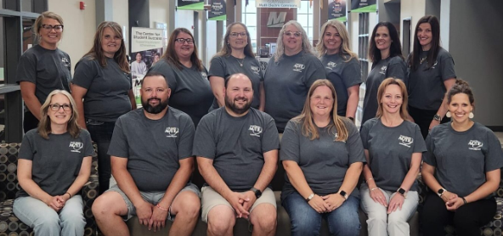
Notes:
3 Different Hats that all coincide:
Hat #1: Executive Director of South Dakota ACTE – Unified state
FOH: Board of Directors Division Presidents, DOE Liaisons, & Upcoming School host/School Host-elect for conference
BOH: Lenessa Keehn, Executive Director [with support from Executive Team]

Slide 3
Notes:
3 Different Hats that all coincide:
Hat #2: Speaker & Workshop Trainer
Opportunities to work with administrators & educators, students, and business/industry professionals

Slide 4
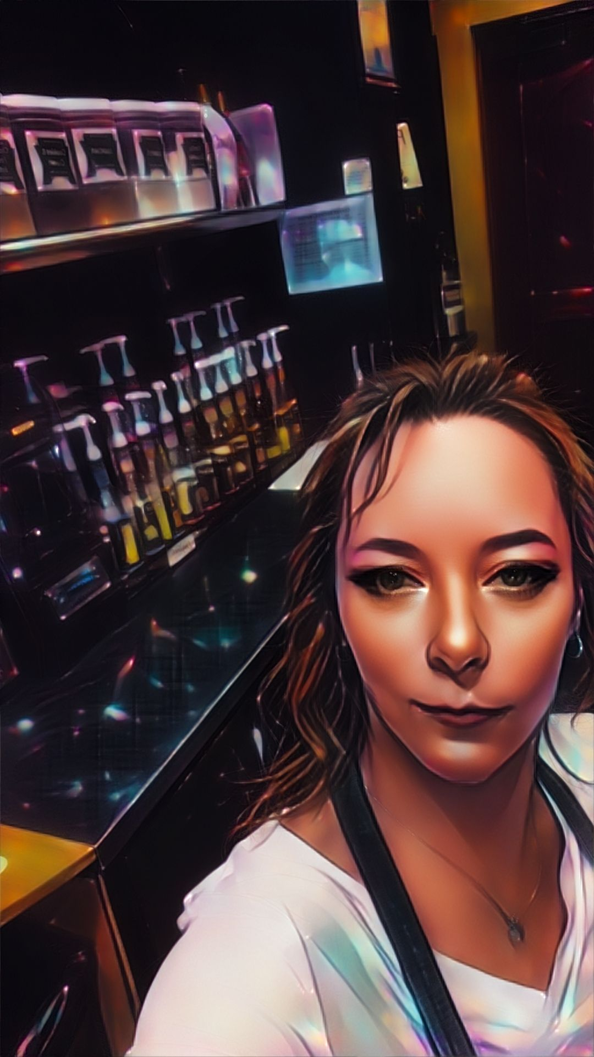
Notes:
3 Different Hats that all coincide:
Hat #3: Barista = this is my “Get out of the house because I work from home” weekend job.
AI / filters make anybody look good!
Historic Deadwood, SD – same as HBO series, modern amenities
FOH: Barista/Gift Shop/Ticket Sales & customer service ||| Board of Directors & member engagement – 1st line of contact & information
BOH: Coffee & Gift Shop manager – operations in scheduling/inventory/employee accountability ||| Executive Director (Staff) – secretary/treasurer & facilitator for board of directors
* Both parties must work synchronously to be able to serve their customers (members) adequately. == take away!

Slide 5
Notes:
Before get started = let’s play a game
Silent Lineup: This can be done in groups of 10 – so tables can join each other. We can do this a couple of times.
1. Line up in height order – shortest to tallest. (Break them in slowly)
2. Line up in Birthday order according to months (no years) January 1st thru December 31st. This one is harder because if there are more than 2 in the same month, they have to communicate this without talking.
Goal: Communication, Collaboration. Easy activity for a 1st day icebreaker. Also allows you to see the inner-thought processes of the students or team that you have. You’ll be able to notice or pick out the passive and the leaders in the group.
SD Exec Team: walk around and facilitate the groups in working together. Encourage more than 1 table to group up (want to have approximately 10 in each group)
Once finished can sit back down: As an Association, each year we have a Board Retreat – this retreat sets the Board of Directors up for their year of service to their divisions and as a Board Member of our organization.

Slide 6
Notes:
What does the Leadership Retreat look like?
This past fall was 1st official Leadership retreat as Executive Director.
2x Previous ExecDir (Dodie) –
Lucky in that DB was at the helm of SDACTE for over 20 years. Fortunate to serve on the Executive Team under her guidance.
Previous/Interim ExecDir – kept the organization going.
New changes, new board, old practices
Doing what is best for us with what we have. So far, in our 53-year history, this is what we’ve found is the model that works for a small state organization with one, part-time staffer, vital partnerships with the DOE and dedicated leaders in our divisions.

Slide 7
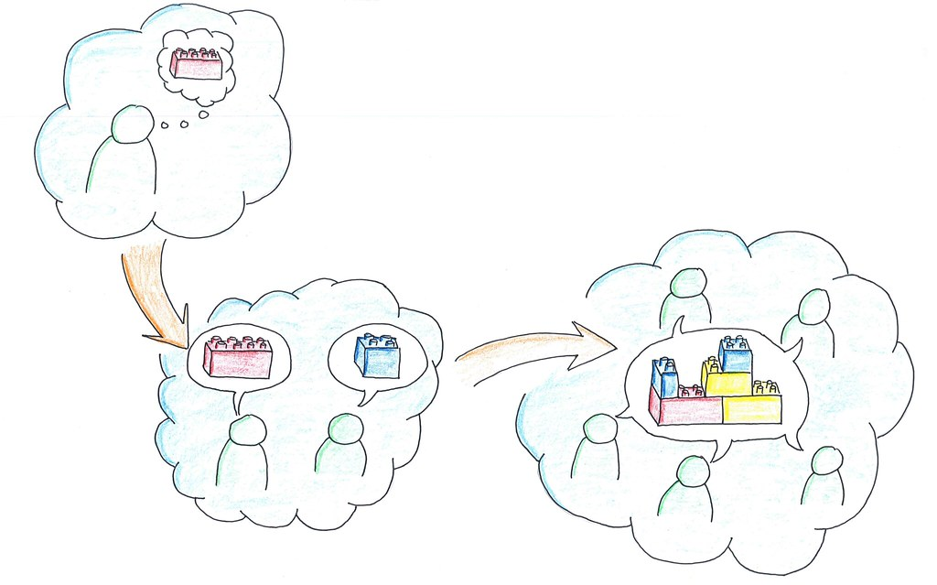
Notes:
Think – Pair – Share Activity:
At the top of the page – write down the mission statement of your state association.
Paid Staff Side: - Think through the structure of your state organization. What does that look like? May/May not have paid staff; may be PT staff; may be FT staff.
* Rotating Leaders: Are these your division presidents? How many divisions do you have? Explain SoDak’s set up (6 divisions)
(Andy/Kelly/Travis – walk around and listen to what the tables are saying; if you find one that is unique or different from ours, encourage them to share out during large group share)
THINK: Take about 3 minutes to Think about the structure/governance of your state organization
PAIR: Share out at your table
SHARE: Share with the large group -

Slide 8
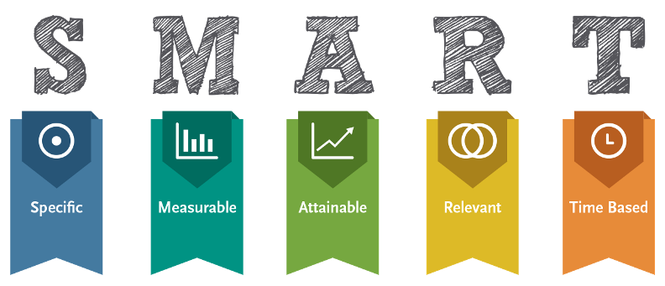
Notes:
SMART GOAL: Specific, Measurable, Attainable, Realistic, Time-bound (other side of page handout)
Strategic Plan format – Goal, Objectives, Resources, Timeline
Division Presidents are the eyes/ears of membership
Reviewed feedback from summer conference
Take a look at needs & improvement for our organization and go from there. Working session that is led by the President with the help of the Past-President
SoDak tries to stick to 2-3 goals. One pertains to our summer conference; the others serve to improve our organization
This is a working document with the entire board and voted on/adopted by the current board as the strategic plan for the current year.

Slide 9
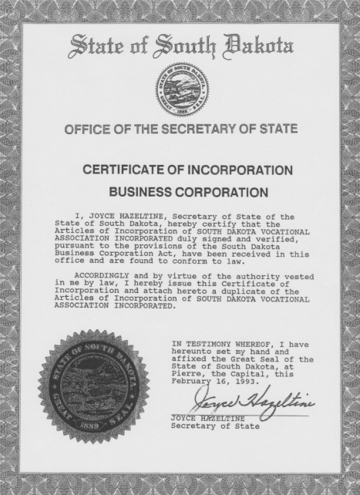
Constitution & Bylaws
Policy Handbook
bit.ly/VISIONsaltSoDak24
Notes:
Give a quick overview of the Constitution & ByLaws as well as the Policy Handbook
Annual Review
Board Approval each fall during Leadership Retreat
Changes have to be approved thru the membership
Last year’s example: Added a floating stipend for Professional Development
Saw requests for other opportunities – Applications are online and sent out to membership as reminders
Discussion at the tables – What does your organization look like? How is it set up? Are there defined roles & responsibilities?
What works really well for your state? What could you do to improve? – discuss for about 5 minutes – share out with large group (Andy/Kelly/Travis walk around & facilitate)

Slide 10
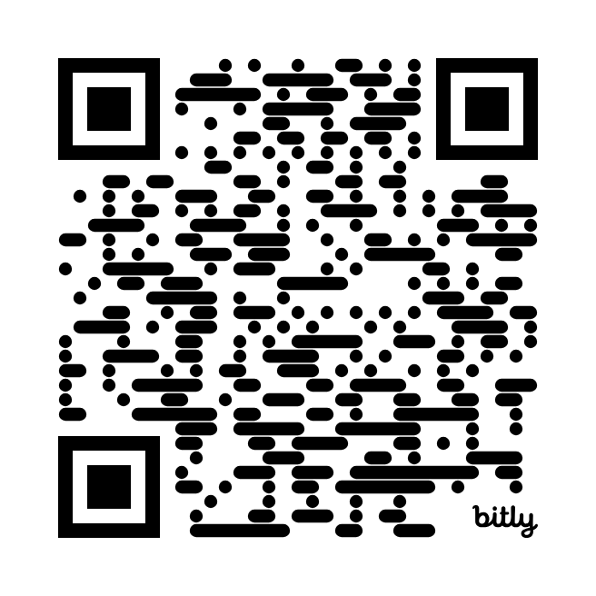
Every State Association can impact their board of directors through leadership, governance, and policy.
Front of House & Back of House must work synchronously to serve their customers adequately.
We’d love your feedback!

