Slide 1
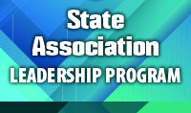
State Association Leadership Training Program
December 4, 2024

Slide 2
Introductions –
NAME
STATE ASSOCIATION
LEADERSHIP POSITION

Slide 3
Morning Kickoff
Welcome & Opening Remarks
Icebreaker: Let’s Get to Know Each Other
Strengthening Leadership Foundations
QAS Criterion Two: Governing Body, Officers, and Directors
State Board Insights: Sharing What Works
Break
Hands-On Collaboration
State Board Work Session
Lunch
Afternoon Deep Dives
Success Story: Revitalizing a State Association
Break
Celebrations and Hot Topics
State Success Stories: Sharing Celebrations
ACTE Hot Topics & Closing Reflection

Slide 4
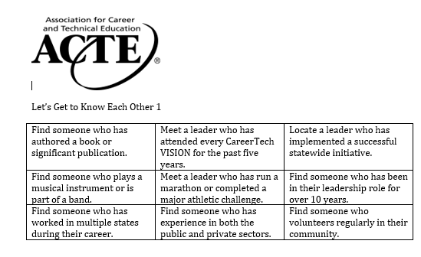

Slide 5
Quality Association Standards (QAS)
Purpose of the QAS:
Provide benchmarks for state associations to assess performance levels.
Help evaluate the quality of service offered to members and prospective members.
Key Objectives:
Aid states in assessing their organizational structure.
Determine whether leadership is delivering minimum, average, or superior programs for members.
Clarifications:
QAS is not a competition between states or a tool to create a “class system” of associations.
It is not designed to evaluate the performance of a state’s executive director or volunteer leaders.
Notes:
The purpose of the Quality Association Standards (QAS) is to provide benchmarks for state associations to determine levels of performance and satisfactory service to their members and prospective members. QAS should be useful to states in evaluating their basic organization and whether their leadership is providing minimum, average or superior programs for the membership. It’s not intended to be a competition between states and/or to establish a “class system” of state associations, nor is it a system for rating the performance of a state’s executive director or volunteer leaders.

Slide 6
CRITERION TWO:
GOVERNING BODY, OFFICERS, AND DIRECTORS
The governing body of the association represents major interests of the membership. Provision for periodic rotation of officers and directors is desirable. The roles of the officers and directors must be clearly defined and the manner in which they are fulfilling their functions demonstrated. Formal orientation procedures for governing body members are in place and regularly conducted.

Slide 7
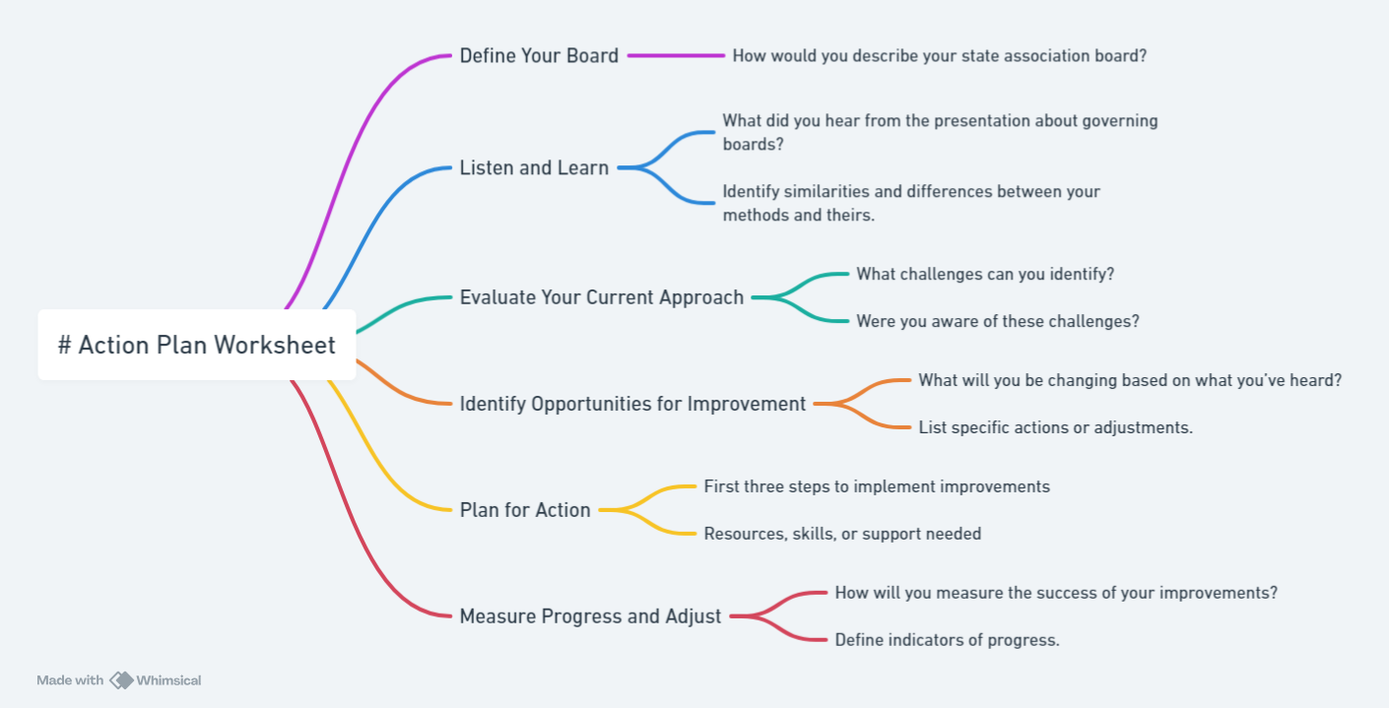

Slide 8
www.acteonline.org

Slide 9
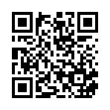
State Association Leadership Training Survey
https://www.surveymonkey.com/r/V24_SALT

